Slide 1

HanDIYcraft
By
Nahathai Kaewtatib 542115018
Pimchanok Sripraphan 542115043

Slide 2
Agenda
Introduction
Our application
Reviews
Aims & objectives
Quality standard
plan

Slide 3


Introduction

Slide 4
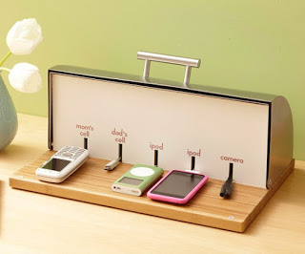
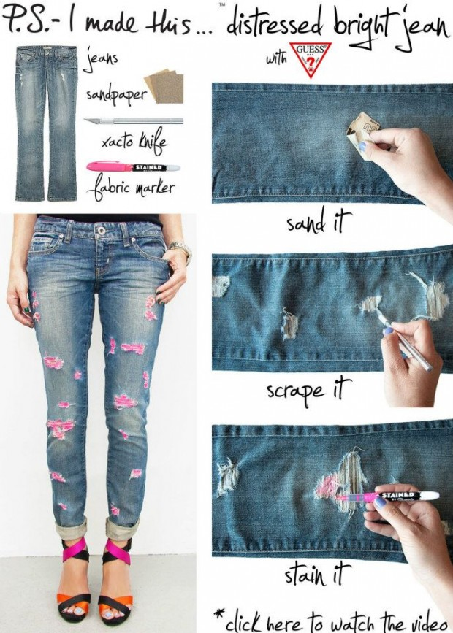
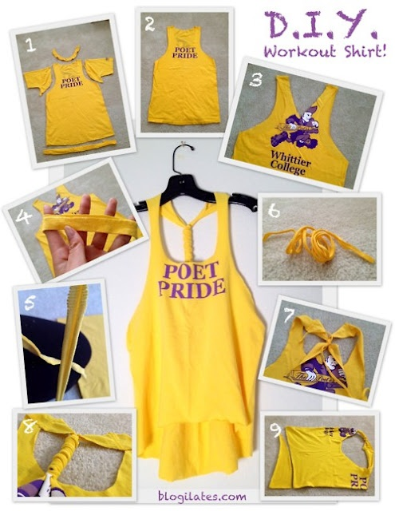


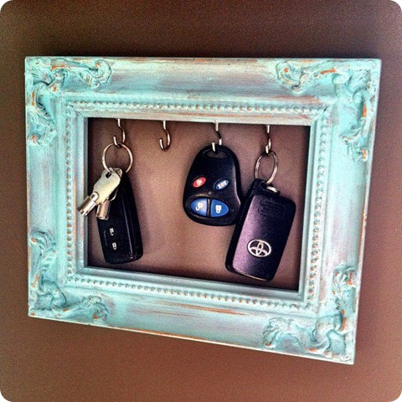
Introduction
Building
Renovating
DO
It
Yourself
modifying
repairing

Slide 5



Introduction

Slide 6
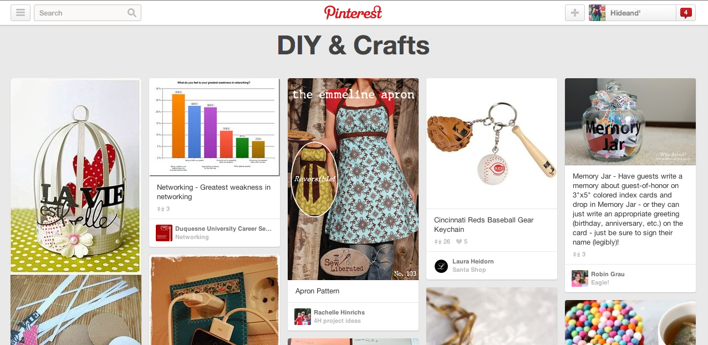
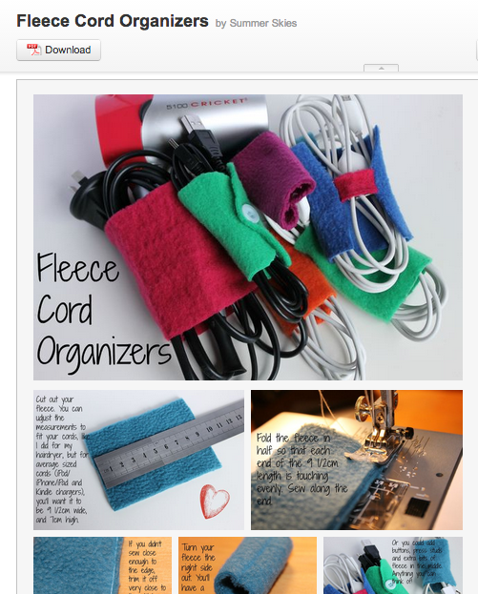
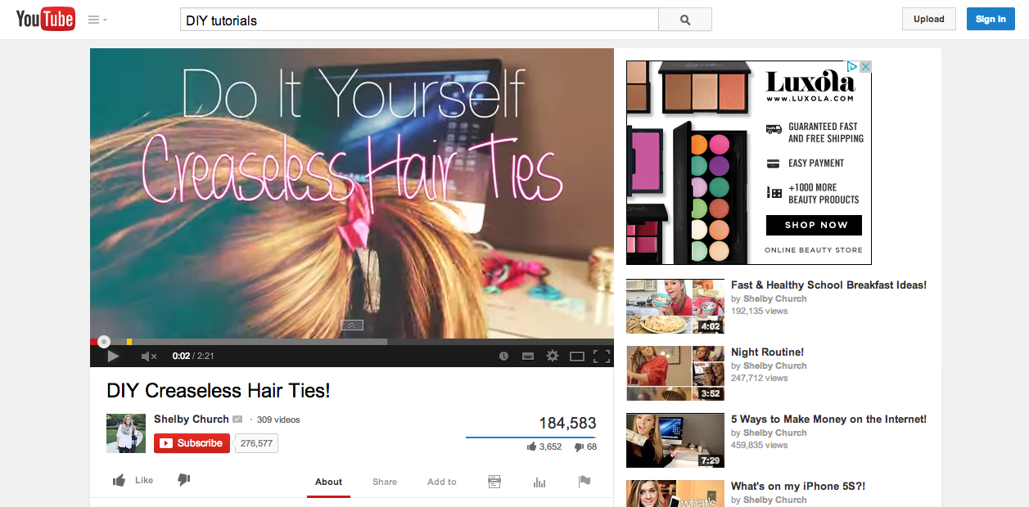

Introduction

Slide 7

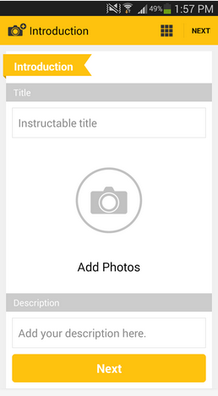
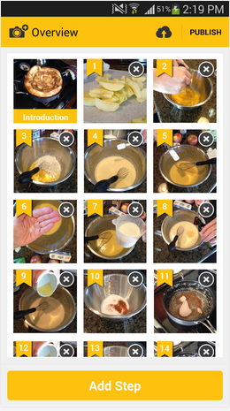
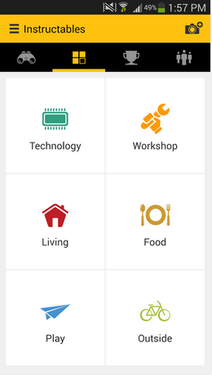
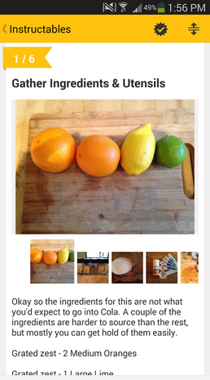
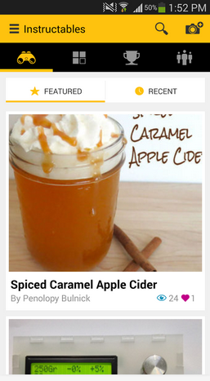

Software
explore
create

Slide 8





Introduction

Slide 9

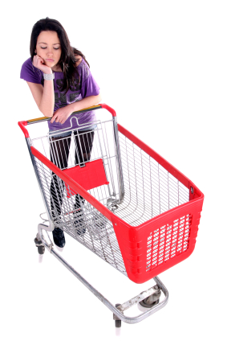

Problems
NO!!!

Slide 10


Problems
Where?
material they want

Slide 11
Our Application

Slide 12






Users
Explore tutorials & shops
send messages
manage tutorials
comment
Search blogger
send messages
manage
shops
user
blogger
shopkeeper

Slide 13






Features

Slide 14
Feature1
Authorization management
Register
system
Log in and
log out system
Displaying profile
Edit
information

Slide 15
Feature2
tutorial management
Manage
tutorials
Display
tutorials
Add details
Step by step
Add pictures

Slide 16
Feature3
shop management
Manage
shops
Add
information
Add pictures

Slide 17
Feature4
map management
Develop Map
>Google maps api<
Shopkeepers
Can add location
Users & bloggers can see shops’ location

Slide 18
Feature5
communication management
Bloggers & shopkeepers can send private messages
Bloggers can comment
Shopkeepers can search bloggers by username

Slide 19
Feature6
notification management
Provide notification for new comment or message

Slide 20



Limits
Operates on
requires
No security
Android os
Internet
connection
Inappropriate
information

Slide 21
Reviews

Slide 22


Architecture
Users
Bloggers
HanDIYcraft
Shopkeepers
request
response
JSON
My SQL
server

Slide 23



Technology

Slide 24



Tools

Slide 25
Aims
and
Objectives

Slide 26


Aims
Users >>> Explore
Bloggers >>> share

Slide 27


Aims
Find shops location
and
guide the direction
Advertise shops

Slide 28





Objectives
Open source

Slide 29








Objectives
manage
Explore

Slide 30
Quality Standard

Slide 31

ISO29110
Project Management Process
Software implementation Process

Slide 32
Plan

Slide 33
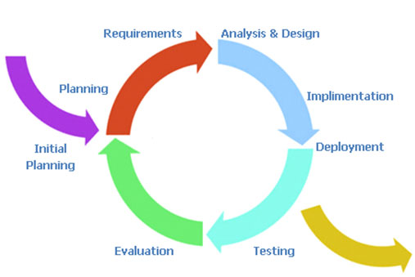
Iterative Model

Slide 34
Deliverables
Progress 1 : feature 1-2
Progress 2 : feature 3-5
Progress Show pro: feature 6
Final Progress : complete system and documents

Slide 35
Q&A

